Slide 1


FINANCIAL PREDICTION USING ML

Slide 2

Module Agenda
Machine Learning 101
Simple Linear Regression
Multiple Linear Regression
Least Squares
Training vs. Testing vs. Validation Split
Decision Trees and Random Forest Intuition
Live Demo: Financial Prediction with GenAI
Practice Opportunity
© All rights reserved for Dr. Ryan Ahmed @Stemplicity Inc.

Slide 3
Financial Planning and Analysis
Data Wrangling & Analysis: Automate reconciliation and analysis of financial data.
Competitor Analysis: Analyze competitors' financials and strategic positioning.
Anomaly Detection: Identify errors in financial transactions with AI.
Time Series Forecasting: Predict financial performance using historical data and market trends.
Variance Analysis: Analyze actuals vs. budgets to pinpoint variances and corrective actions.
Scenario Planning: Model scenarios to evaluate business decisions' financial impacts.
Financial Narratives: Generate AI-driven insights for clear stakeholder communication.
Cost Optimization: Identify inefficiencies and recommend cost-saving measures.
Data Visualization: Visualize financial data for strategic decision making
Financial Prediction Using ML Regression: Predict financial metrics such as revenues& expenses.
Financial Planning and Analysis (FP&A) is a critical business function that focuses on providing financial insights to support decision-making and drive a company’s strategic objectives.
It involves analyzing financial data, forecasting future financial performance, budgeting, and offering recommendations to enhance financial health and operational efficiency.
© All rights reserved for Dr. Ryan Ahmed @Stemplicity Inc.

Slide 4
MACHINE LEARNING 101

Slide 5
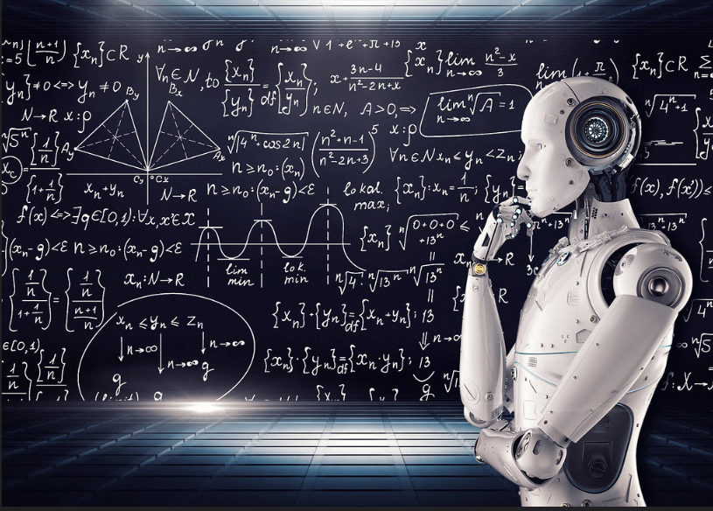
Machine Learning 101
Machine Learning is a branch of artificial intelligence (AI) that allows computers to learn without being explicitly programmed.
Instead of following predefined rules, ML systems analyze patterns in data to predict outcomes.
Key Features:
Data-driven: ML relies on large amounts of data for training.
Automation: Models learn without being explicitly programmed.
Applications: Used in recommendation systems, image recognition, & language translation.
© All rights reserved for Dr. Ryan Ahmed @Stemplicity Inc.
Photo Credit: https://www.flickr.com/photos/mikemacmarketing/30212411048

Slide 6
AI Vs. ML Vs. DL Vs. GenAI
Artificial intelligence (AI) is a branch of computer science focused on solving problems related to human intelligence, such as learning and creativity.
Machine Learning (ML) is a subfield of AI that enables machines to improve at a given task with experience and without explicit instructions.
Artificial Intelligence (AI)
Deep learning (DL) is a subset of ML that uses artificial neural networks to learn from large amounts of data, enabling complex tasks like image and speech recognition.
Machine Learning (ML)
© All rights reserved for Dr. Ryan Ahmed @Stemplicity Inc.
Generative AI (GenAI) is a type of AI that can create new content distinct from the content/data on which it was trained on.
Deep Learning (DL)
Generative AI

Slide 7
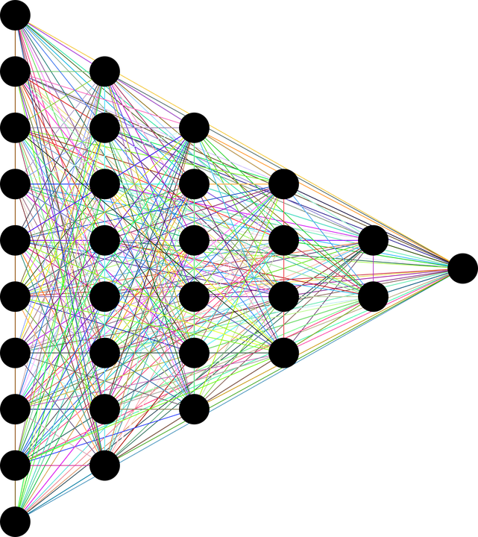
What is Deep Learning
Deep Learning is a specialized field of Machine Learning that relies on training in Deep Artificial Neural Networks (ANNs) using large datasets such as images.
ANNs are information-processing models inspired by the human brain.
The human brain consists of billions of neurons that communicate with each other using electrical and chemical signals and enable humans to see, feel, and make decisions.
INPUT DATA
TARGET OUTPUTS
© All rights reserved for Dr. Ryan Ahmed @Stemplicity Inc.
DEEP (HIDDEN LAYERS)
Photo Credit: https://pixabay.com/en/neural-network-thought-mind-mental-3816319/

Slide 8
Machine Learning Big Picture
ARTIFICIAL INTELLIGENCE
Science that enables computers to mimic human intelligence. Subfields: Machine Learning, robotics, and computer vision
MACHINE LEARNING
Subset of AI that enables machines to improve at tasks with experience
SUPERVISED LEARNING
Training algorithms using labeled input/output data.
CLASSIFICATION
REGRESSION
UNSUPERVISED LEARNING
Training algorithms with no labelled data. It attempts to discover hidden patterns on its own.
CLUSTERING
© All rights reserved for Dr. Ryan Ahmed @Stemplicity Inc.
REINFORCEMENT LEARNING
The algorithm takes actions to maximize cumulative reward.

Slide 9
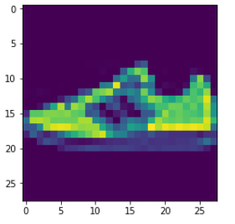
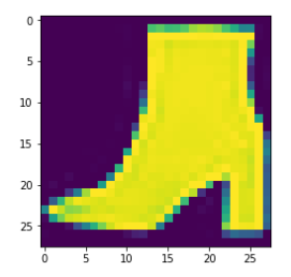
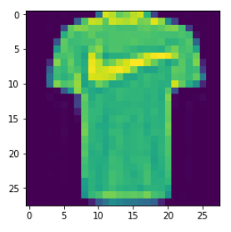
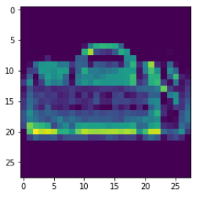
Machine Learning: Supervised Learning
Supervised machine learning is a type of machine learning where the algorithm is trained on a labelled dataset.
DESIRED OUTPUT
TARGET CLASSES (LABELS)
INPUT DATA
T-SHIRT/TOP
TROUSER
PULLOVER
DRESS
COAT
SANDAL
SHIRT
SNEAKER
BAG
ANKLE BOOT
© All rights reserved for Dr. Ryan Ahmed @Stemplicity Inc.
Supervised Machine Learning Model

Slide 10
Machine Learning: Unsupervised Learning
Unsupervised learning is a machine learning approach where algorithms analyze and identify patterns in datasets without predefined labels.
OUTPUT DATA CLUSTERS
INPUT DATA
Unsupervised Machine Learning Model
© All rights reserved for Dr. Ryan Ahmed @Stemplicity Inc.

Slide 11
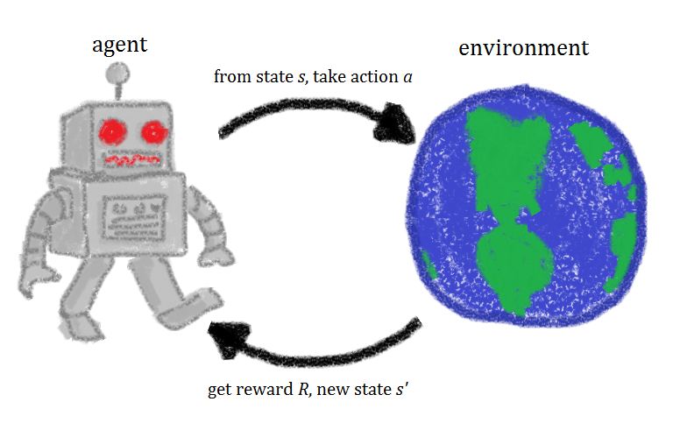



Machine Learning: Reinforcement Learning
Reinforcement Learning (RL) is a type of machine learning in which an agent learns to make decisions by interacting with an environment to maximize cumulative rewards.
Through trial and error, the agent receives feedback—rewards for correct actions and penalties for incorrect ones—and uses this to improve its decision-making over time.
ENVIRONMENT
AGENT
-10 Points
© All rights reserved for Dr. Ryan Ahmed @Stemplicity Inc.
+10 Points
Photo Credit: https://commons.wikimedia.org/wiki/File:Rl_agent.png

Slide 12
DATA TYPES AND SOURCES

Slide 13


Labelled vs. Unlabeled Data
Unlabeled Dataset
Labelled Dataset
Unlabeled data consists of data that does not have an explanation (class or tag) associated with it.
Labelled data consists of data but with a “class” or “tag” associated with it.
© All rights reserved for Dr. Ryan Ahmed @Stemplicity Inc.
label = “cat”
label = “dog”
Photo Credit: https://www.pexels.com/photo/grey-and-white-short-fur-cat-104827/
Photo Credit: https://www.pexels.com/photo/portrait-of-a-dog-257540/

Slide 14
Good vs. Bad Data
Aspect | Good Data | Bad Data
Accuracy | Reflects real-world values or facts accurately. | Contains errors, typos, or incorrect information.
Completeness | All necessary information is available. | Missing values or incomplete records.
Consistency | Uniform across all entries (e.g., formats, units). | Inconsistent formats or units (e.g., "kg" vs. "lbs").
Relevance | Directly applicable to the problem or analysis. | Irrelevant or outdated information included.
Timeliness | Up-to-date and reflects current scenarios. | Outdated or stale data.
Duplication | Unique entries without redundancy. | Contains duplicate or redundant records.
Bias | Balanced and unbiased representation. | Skewed or biased toward specific groups/outcomes.
Noise | Free of unnecessary or irrelevant details. | Includes extraneous or irrelevant information.
Accessibility | Easy to retrieve and use for analysis. | Difficult to access or poorly formatted.
Validity | Complies with defined rules and constraints. | Violates rules (e.g., incorrect date formats).
© All rights reserved for Dr. Ryan Ahmed @Stemplicity Inc.

Slide 15
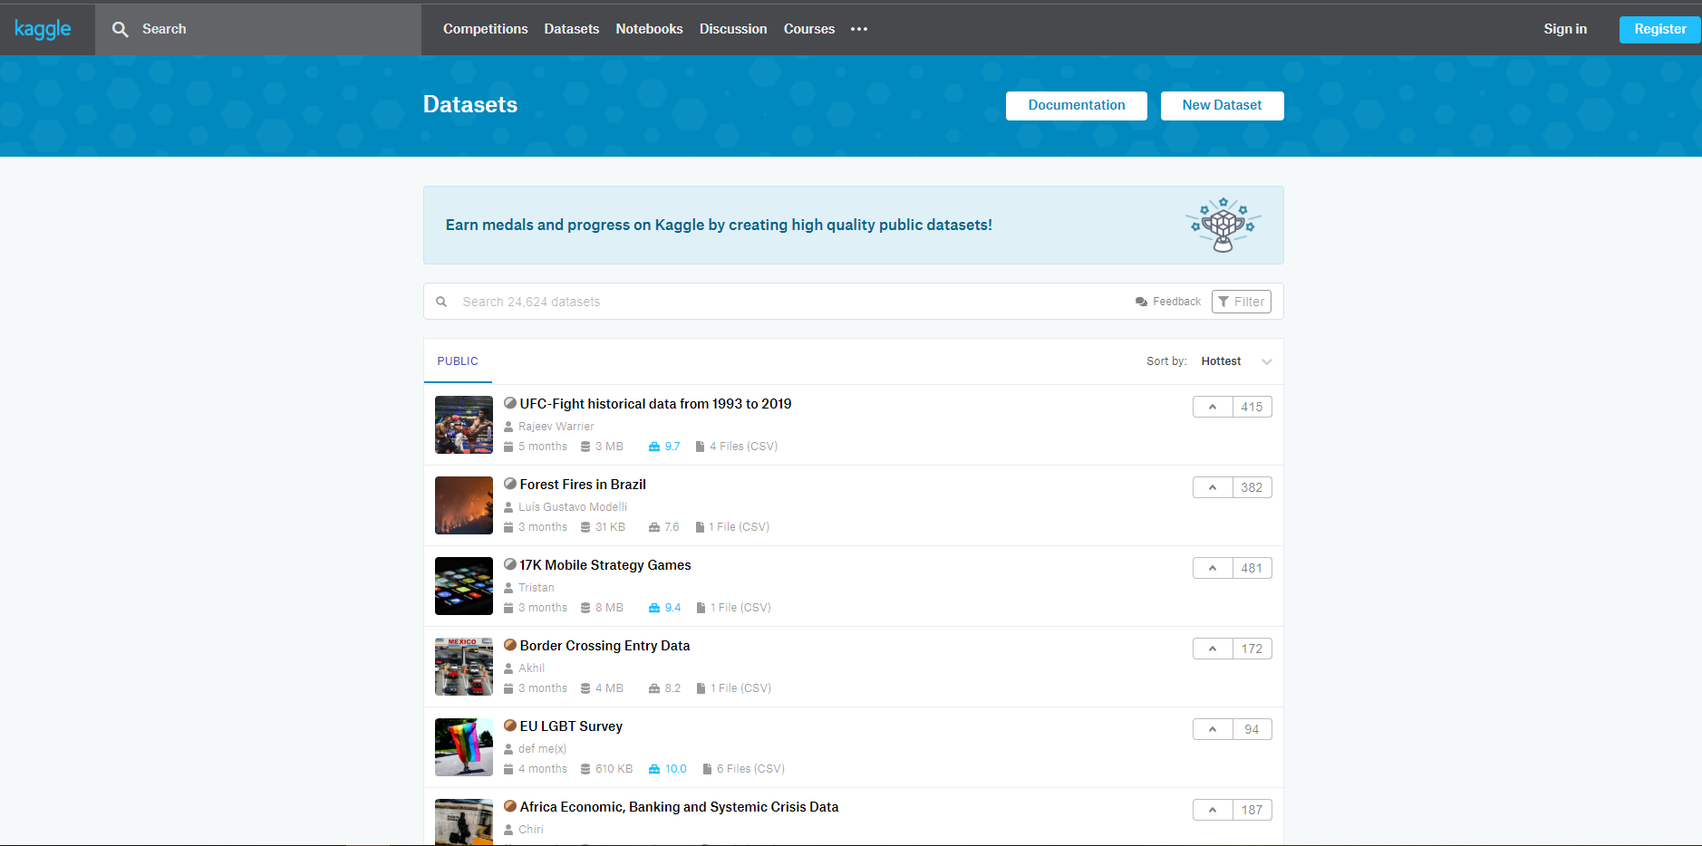
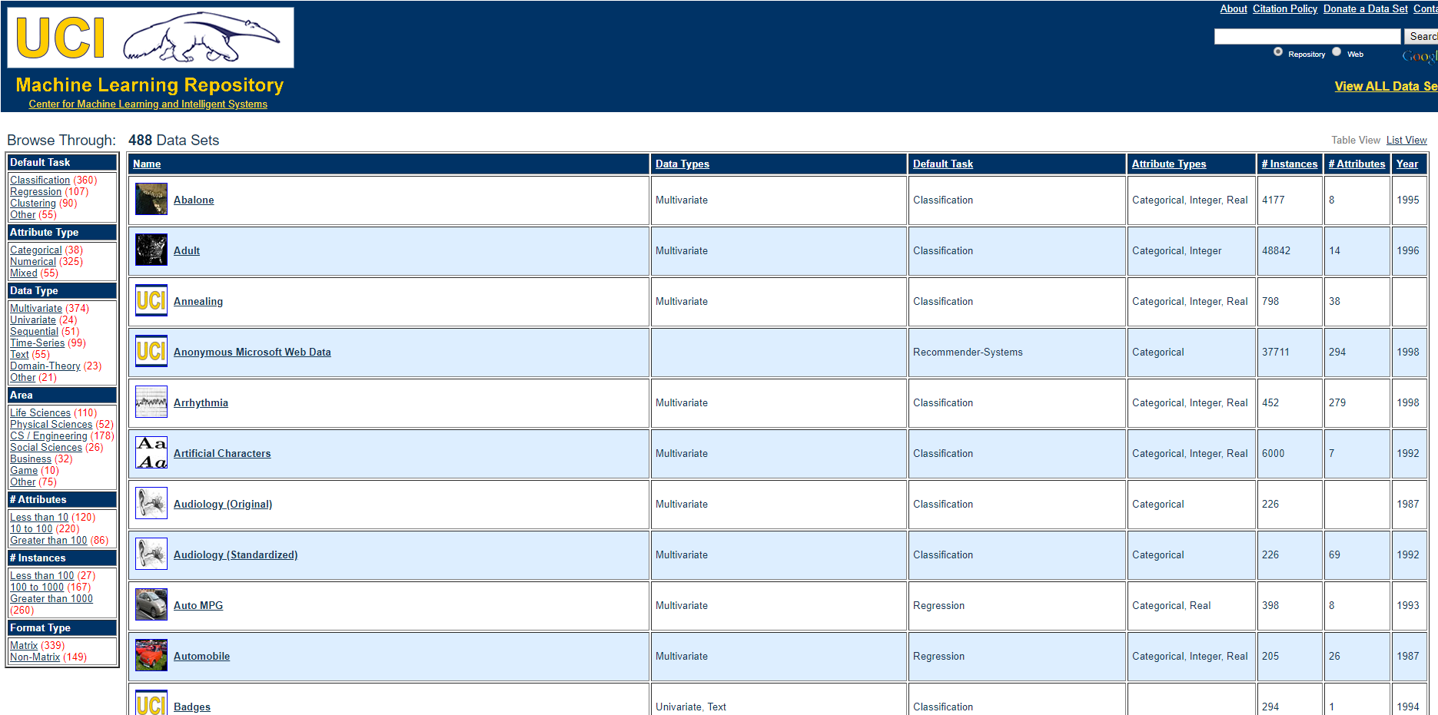
Data Sources
Data could also come from multiple sources such as Kaggle, UCI, AWS Dataset, and ImageNet.
ImageNet is an open-source repository of images consisting of 21,841 subcategories (classes) and over 14 million images.
© All rights reserved for Dr. Ryan Ahmed @Stemplicity Inc.
Check out the website here: https://archive.ics.uci.edu/ml/datasets.php
Check out the website here: https://www.kaggle.com/datasets

Slide 16
MACHINE LEARNING REGRESSION 101

Slide 17


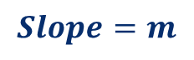
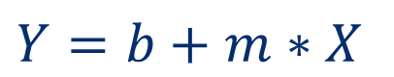
Simple Linear Regression
In simple linear regression, we predict the value of one variable, Y, based on another variable, X, where X is called the independent variable and Y is called the dependent variable.
It is called simple because it examines the relationship between two variables only.
Y-Intercept
$800,000
Slope
$$Y=b+m∗X$$
© All rights reserved for Dr. Ryan Ahmed @Stemplicity Inc.
House Price ($)
$$Slope=m$$
Dependent Variable
Independent Variable
$$b$$
2000 sqft
House Size (Sq. ft.)

Slide 18
Multiple Linear Regression
Multiple Linear Regression examines the relationship between more than two variables.
Each independent variable has its own corresponding coefficient.
Model Coefficients
© All rights reserved for Dr. Ryan Ahmed @Stemplicity Inc.
$$Y=b_{0}+b_{1}∗X_{1}+b_{2}∗X_{2}+..+b_{n}X_{n}$$
Dependent Variable (House Price)
Independent Variables (House Size, Number of Bedrooms, Number of Bathrooms..etc.)

Slide 19
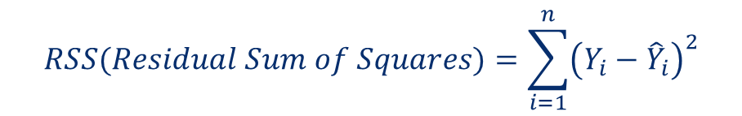

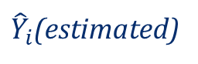
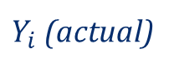
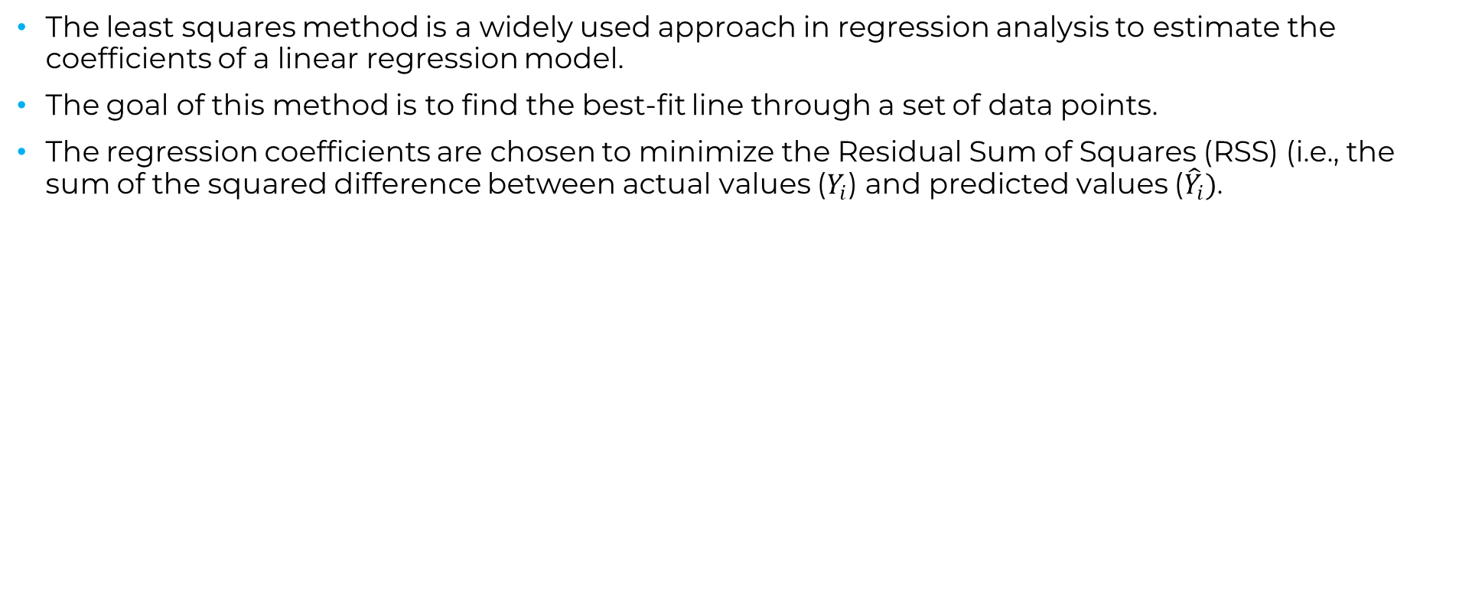
Least Squares Method
The least squares method is a widely used approach in regression analysis to estimate the coefficients of a linear regression model.
The goal of this method is to find the best-fit line through a set of data points.
The regression coefficients are chosen to minimize the Residual Sum of Squares (RSS) (i.e., the sum of the squared difference between actual values ($Y_{i}$) and predicted values (${\hat{Y}}_{i})$.
$$RSS(Residual Sum of Squares)=\sum_{i=1}^{n}{{\left(Y_{i}−{\hat{Y}}_{i}\right)}^{2}}$$
$Y_{i}$ (actual)
© All rights reserved for Dr. Ryan Ahmed @Stemplicity Inc.
$$error$$
House Price ($)
${\hat{Y}}_{i}$(estimated)
House Size (Sq. ft.)

Slide 20
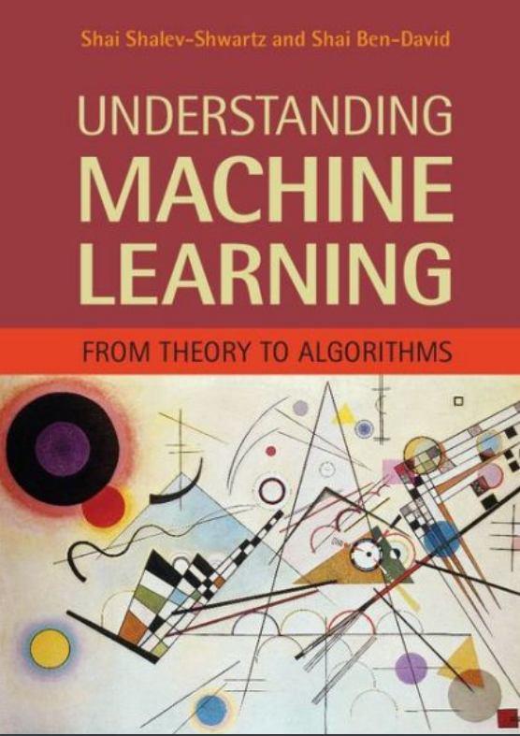
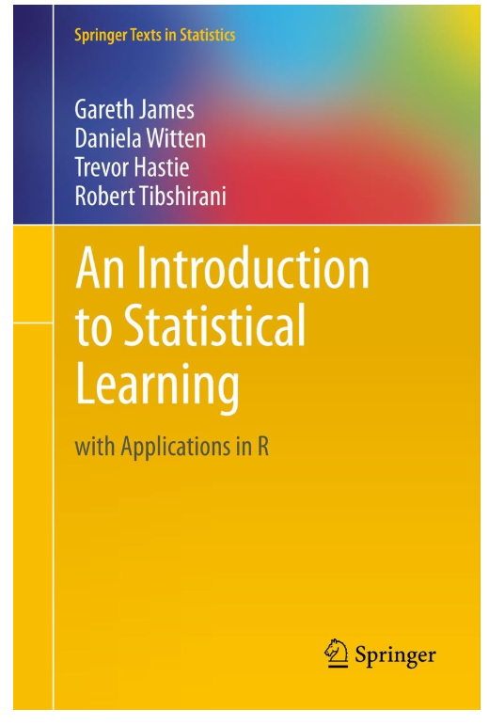
Simple Linear Regression: Reading Materials
Additional Resources, Page #123: http://www.cs.huji.ac.il/~shais/UnderstandingMachineLearning/understanding-machine-learning-theory-algorithms.pdf
Additional Resources, Page #61: http://www-bcf.usc.edu/~gareth/ISL/ISLR%20Seventh%20Printing.pdf
© All rights reserved for Dr. Ryan Ahmed @Stemplicity Inc.

Slide 21
PRACTICE OPPORTUNITY

Slide 22
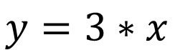
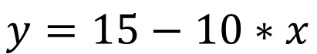
Practice Opportunity
Can you draw these equations?
$$y=3∗x$$
$$y=15−10∗x$$
© All rights reserved for Dr. Ryan Ahmed @Stemplicity Inc.

Slide 23
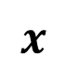

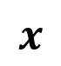

Practice Opportunity Solution
Can you draw these equations?
$$y=3∗x$$
$$y=15−10∗x$$
$$y$$
© All rights reserved for Dr. Ryan Ahmed @Stemplicity Inc.
$$y$$
$$x$$
$$x$$

Slide 24
MACHINE LEARNING REGRESSION METRICS

Slide 25

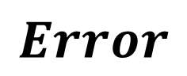
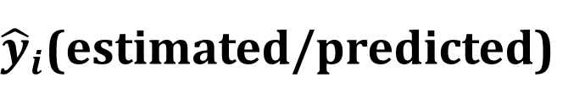
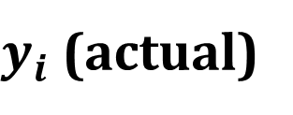
Regression Metrics
After model fitting, we would like to assess the performance of the model by comparing model predictions to actual (True) data
$$Residuals (Error)={\hat{y}}_{i}−y_{i}$$
$y_{i}$ (actual)
$$Error$$
Revenue($)
${\hat{y}}_{i}$(estimated/predicted)
© All rights reserved for Dr. Ryan Ahmed @Stemplicity Inc.
Temperature (degC)
Source: https://www.goodfreephotos.com/vector-images/ice-cream-stand-vector-clipart.png.php

Slide 26
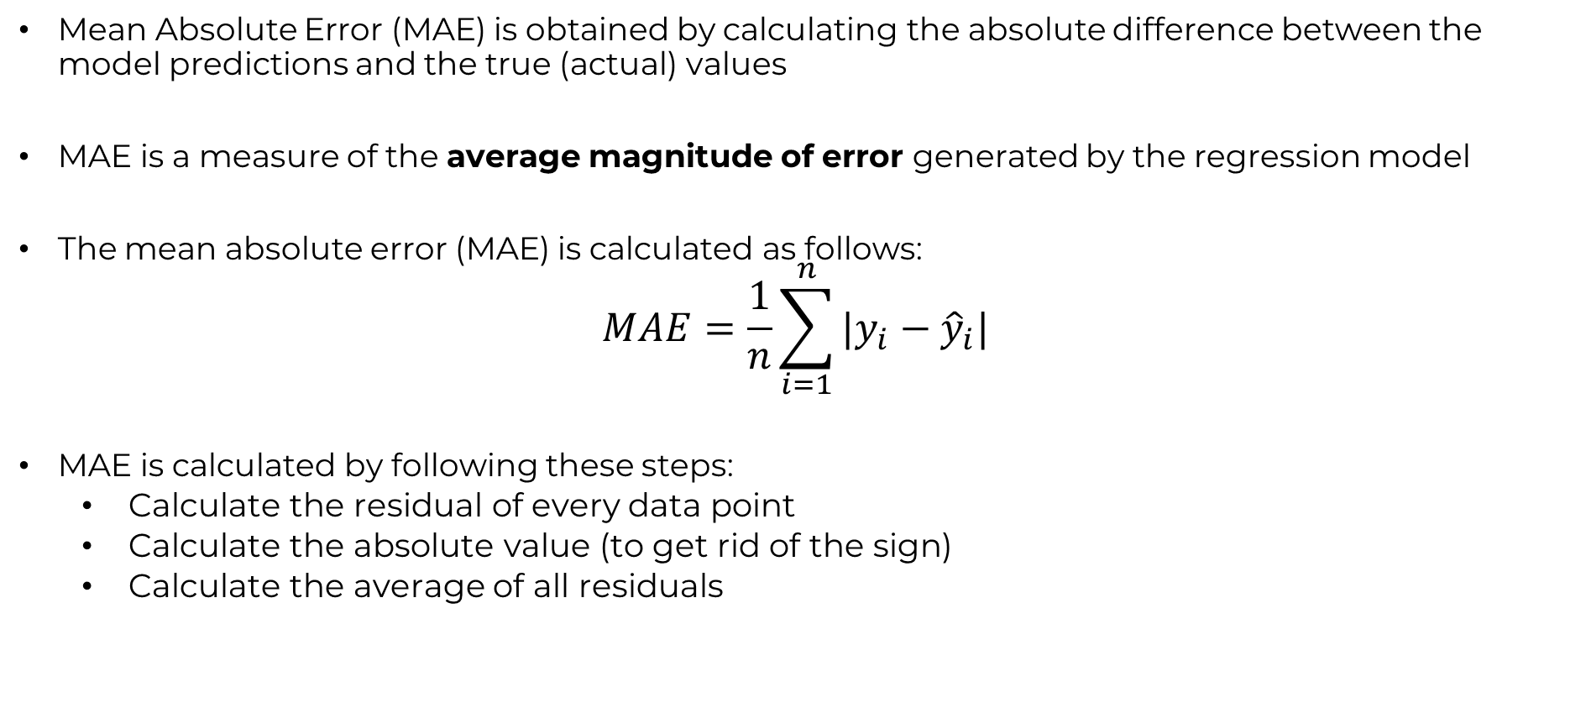
Regression Metrics: Mean Absolute Error (MAE)
Mean Absolute Error (MAE) is obtained by calculating the absolute difference between the model predictions and the true (actual) values
MAE is a measure of the average magnitude of error generated by the regression model
The mean absolute error (MAE) is calculated as follows:
$$MAE=\frac{1}{n}\sum_{i=1}^{n}{|y_{i}−{\hat{y}}_{i}|}$$
MAE is calculated by following these steps:
Calculate the residual of every data point
Calculate the absolute value (to get rid of the sign)
Calculate the average of all residuals
© All rights reserved for Dr. Ryan Ahmed @Stemplicity Inc.

Slide 27
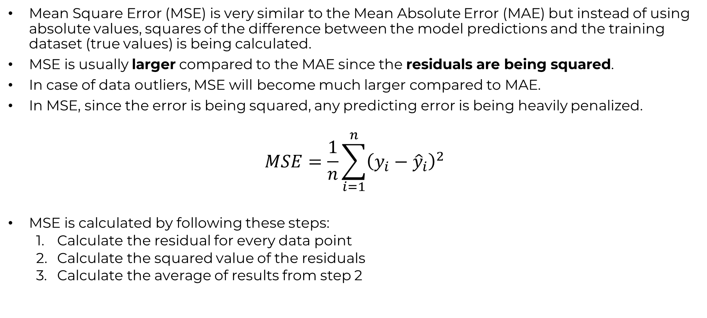
Regression Metrics: Mean Square Error (MSE)
Mean Square Error (MSE) is very similar to the Mean Absolute Error (MAE) but instead of using absolute values, squares of the difference between the model predictions and the training dataset (true values) is being calculated.
MSE is usually larger compared to the MAE since the residuals are being squared.
In case of data outliers, MSE will become much larger compared to MAE.
In MSE, since the error is being squared, any predicting error is being heavily penalized.
$$MSE=\frac{1}{n}\sum_{i=1}^{n}{{\left(y_{i}−{\hat{y}}_{i}\right)}^{2}}$$
MSE is calculated by following these steps:
Calculate the residual for every data point
Calculate the squared value of the residuals
Calculate the average of results from step 2
© All rights reserved for Dr. Ryan Ahmed @Stemplicity Inc.

Slide 28
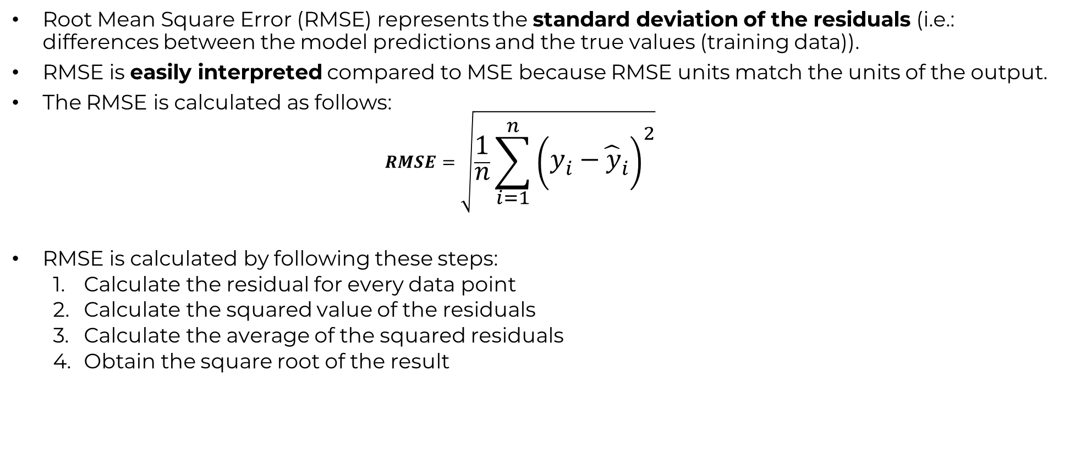
Regression Metrics: Root Mean Square Error (RMSE)
Root Mean Square Error (RMSE) represents the standard deviation of the residuals (i.e.: differences between the model predictions and the true values (training data)).
RMSE is easily interpreted compared to MSE because RMSE units match the units of the output.
The RMSE is calculated as follows:
$$RMSE=\sqrt{\frac{1}{n}\sum_{i=1}^{n}{{\left(y_{i}−{\hat{y}}_{i}\right)}^{2}}}$$
RMSE is calculated by following these steps:
Calculate the residual for every data point
Calculate the squared value of the residuals
Calculate the average of the squared residuals
Obtain the square root of the result
© All rights reserved for Dr. Ryan Ahmed @Stemplicity Inc.

Slide 29
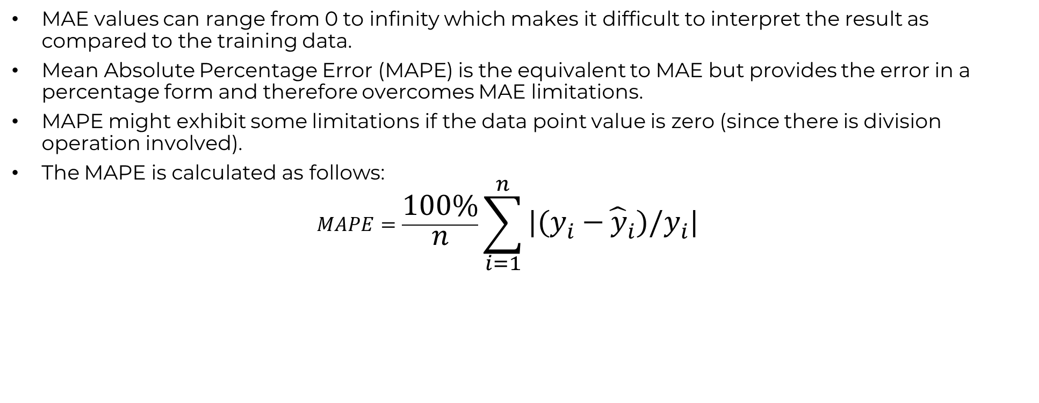
Regression Metrics: Mean Absolute Percentage Error (MAPE)
MAE values can range from 0 to infinity which makes it difficult to interpret the result as compared to the training data.
Mean Absolute Percentage Error (MAPE) is the equivalent to MAE but provides the error in a percentage form and therefore overcomes MAE limitations.
MAPE might exhibit some limitations if the data point value is zero (since there is division operation involved).
The MAPE is calculated as follows:
$$MAPE=\frac{100\%}{n}\sum_{i=1}^{n}{|(y_{i}−{\hat{y}}_{i})/y_{i}|}$$
© All rights reserved for Dr. Ryan Ahmed @Stemplicity Inc.

Slide 30

Regression Metrics: R Square ($R^{2}$)
R-square or the coefficient of determination represents the proportion of variance (of y) that has been explained by the independent variables in the model.
If $R^{2}=80$, this means that 80% of the increase in ice cream cart revenue is due to increase in temperature.
© All rights reserved for Dr. Ryan Ahmed @Stemplicity Inc.
Revenue($)
Temperature (degC)
Source: https://www.goodfreephotos.com/vector-images/ice-cream-stand-vector-clipart.png.php

Slide 31
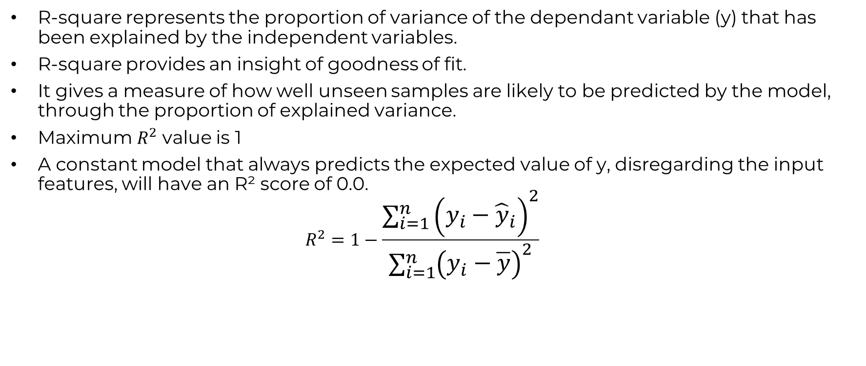
Regression Metrics: R Square ($R^{2}$)
R-square represents the proportion of variance of the dependant variable (y) that has been explained by the independent variables.
R-square provides an insight of goodness of fit.
It gives a measure of how well unseen samples are likely to be predicted by the model, through the proportion of explained variance.
Maximum $R^{2}$ value is 1
A constant model that always predicts the expected value of y, disregarding the input features, will have an R² score of 0.0.
$$R^{2}=1−\frac{\sum_{i=1}^{n}{{\left(y_{i}−{\hat{y}}_{i}\right)}^{2}}}{\sum_{i=1}^{n}{{\left(y_{i}−\overline{y}\right)}^{2}}}$$
© All rights reserved for Dr. Ryan Ahmed @Stemplicity Inc.

Slide 32
DATA SPLIT IN MACHINE LEARNING

Slide 33
Data Split: Training Vs. Testing
In machine learning, the objective is to train a model that can generate accurate predictions on unseen data.
The simplest method is to divide the available dataset into two subsets:
Training subset: used to train the model
Testing (holdout) subset: used to evaluate the final performance of the trained model. Testing subset has never been seen by the model during training.
Training
80%
Available Dataset
© All rights reserved for Dr. Ryan Ahmed @Stemplicity Inc.
Testing
20%

Slide 34
Data Split: Training Vs. Testing Vs. Validation
In some situations, the available dataset is split into 3 subsets:
Training subset: used to train the model
Validation (cross-validation) subset: used to tune the model hyperparameters and to evaluate the training process quality as training proceeds.
Testing (holdout) subset: used to evaluate the final performance of the trained model. Testing subset has never been seen by the model during training.
Training
60%
Available Dataset
Validation
20%
© All rights reserved for Dr. Ryan Ahmed @Stemplicity Inc.
Testing
20%

Slide 35
DECISION TREES & RANDOM FOREST

Slide 36
Decision Trees
A decision tree is a widely used machine learning algorithm used to solve classification and regression problems.
It is a tree-structured algorithm that includes a sequence of decisions and their possible outcomes. In decision trees, data is split according to a certain condition.
Let’s assume that we want to classify whether a bank customer is eligible to retire based on features such as savings and age.
© All rights reserved for Dr. Ryan Ahmed @Stemplicity Inc.
Savings>$1M
Age
Yes
No
55 years
Age > 55?
Class 0
Yes
No
Class 1
Class 0
$1 Million
Savings

Slide 37
Decision Trees Terminologies
Decision trees consist of initial (root), decision, and terminal nodes.
We start at the initial (root) node and move down the tree, where data is partitioned at decision nodes into smaller groups until terminal nodes containing predicted labels are formed.
The algorithm chooses the feature and cutoff value at each node that generates the widest separation of the labeled data to minimize the error (Ex.: mean-squared error).
© All rights reserved for Dr. Ryan Ahmed @Stemplicity Inc.
Initial (Root) Node
Savings>$1M
Yes
No
Decision Node
With Cutoff Value = 55
Age > 55?
Class 0
Yes
No
Class 1
Class 0
Terminal Node

Slide 38
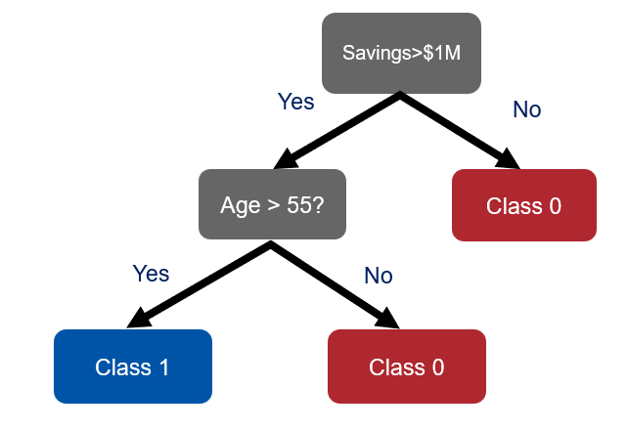
Random Forest
Instead of basing predictions on the results of a single decision tree, why not use the predictions of an ensemble of models?
Random Forest is a type of ensemble algorithms that combines predictions from a collection of models. Ensemble algorithms typically generates more accurate and stable predictions compared to a single model.
Random Forest works by creating a set of decision trees from randomly selected subset of data. It then combines votes or average values from different decision trees to generate a final prediction which represents the “wisdom of the crowds”.
© All rights reserved for Dr. Ryan Ahmed @Stemplicity Inc.
Decision Tree 1
Decision Tree 2
Decision Tree N
Random Forest
MAJORITY VOTE = CLASS #1

Slide 39
LIVE DEMO: FINANCIAL FORECASTING WITH GENAI

Slide 40
Project Overview
In this project, we will perform financial forecasting using Machine Learning (ML) techniques.
We will predict companies’ future quarterly Earnings Per Share (EPS) using historical data from financial statements such as balance sheets, income statements, and cash flow statements.
Inputs (X)
Balance Sheet
Income Statement
Cash Flow Statement
(Ex: Assets, Liabilities, debt-to-income ratios,..etc.)
Machine Learning Model
Outputs (Y)
Future Earnings Per Share
© All rights reserved for Dr. Ryan Ahmed @Stemplicity Inc.

Slide 41
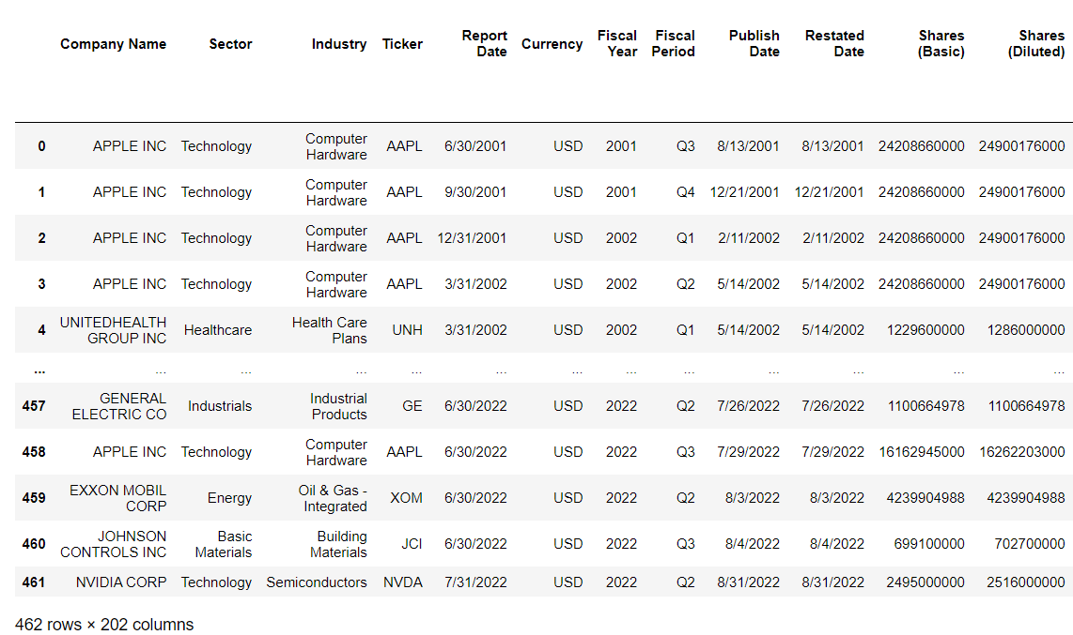
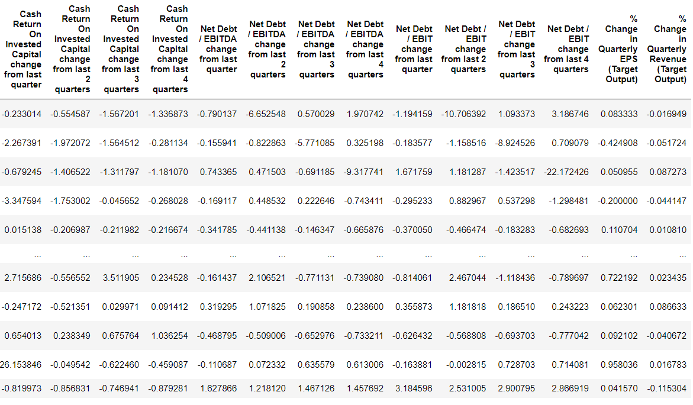
Data Overview
The data contains over 200 inputs such as company name, industry, revenue, interest expense, and dividends paid.
The data contains the following output:
Next quarter % change in Earnings Per Share (EPS)
Inputs
Output
© All rights reserved for Dr. Ryan Ahmed @Stemplicity Inc.

Slide 42
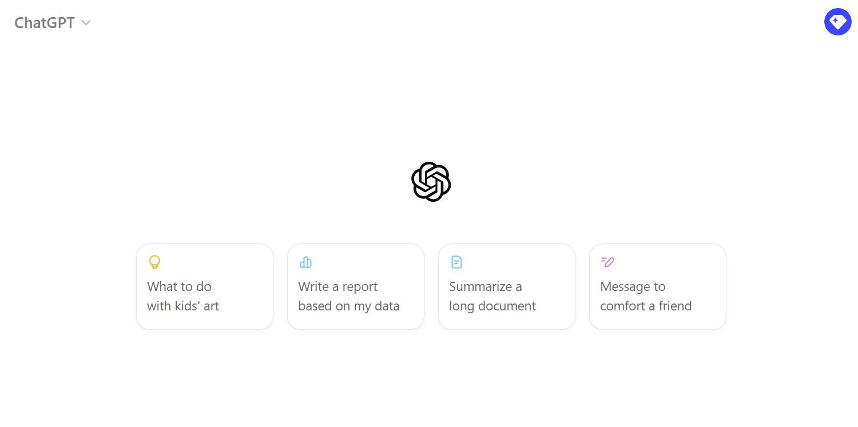
Live Demo:
🔗 Click here to explore ChatGPT ChatGPT Signup
💡 Click here for AI Prompts Explore Prompts
© All rights reserved for Dr. Ryan Ahmed @Stemplicity Inc.

Slide 43
PRACTICE OPPORTUNITY

Slide 44

Practice Opportunity
In this machine learning project, you will work with a dataset representing Walmart’s quarterly financial performance, comprising key economic features:
Store_Count: The number of Walmart stores in operation.
Housing_Starts: The number of new residential construction projects started.
Interest_Rates: Average interest rates over the quarter.
Consumer_Confidence: A measure of consumer optimism regarding the state of the economy.
Home_Improvement_Spend: Consumer spending on home improvement projects.
Quarterly_Revenue: Total revenue generated by Walmart in the quarter.
Quarterly_EPS: Earnings per share, a profitability measure for shareholders.
The dataset contains 40 quarters of financial data, with the primary objectives of predicting Quarterly Revenue and Earnings Per Share (EPS) using linear regression techniques. By leveraging this dataset, students will explore how various economic indicators interconnect and influence a home improvement retailer's financial metrics, gaining practical experience in data preprocessing, model training, performance evaluation, and interpreting machine learning predictions.
© All rights reserved for Dr. Ryan Ahmed @Stemplicity Inc.

Slide 45
Practice Opportunity
Tasks for Students:
Load and explore Walmart’s financial dataset
Understand the meaning and potential impact of each feature on financial predictions
Perform data preprocessing and feature scaling
Split the dataset into training and testing sets
Train linear regression models for revenue and EPS prediction
Evaluate model performance using Mean Squared Error (MSE) and R-squared metrics
Analyze feature importance and its implications for financial forecasting
Create visualizations comparing actual vs. predicted values
Interpret the model's strengths and limitations
© All rights reserved for Dr. Ryan Ahmed @Stemplicity Inc.

Slide 46
Practice Opportunity Solutions
🔗 Click here to explore ChatGPT ChatGPT Signup
💡 Click here for AI Prompts Explore Prompts
💡 Click here for Practice Opportunities Solution Explore Prompts
© All rights reserved for Dr. Ryan Ahmed @Stemplicity Inc.

Slide 47
Thank you!

